Slide 1

777 Football Group
Brasileirão Série A Analysis
January 2023

Slide 2
Contents
Executive Summary 3
Model Overview 4
Model Web Page 5
Diagnostic - The Outliers 6
Squad Structure of Outlier Clubs 7
Current Squad - Vasco 9
European Leagues with 10 Potential Recruits
Sensible Transfers 13

Slide 3
Executive Summary
Problems in Brasileirão Série A
Data analytics in the Brasileirão Série A is still a growing sector and without the power of data, players are often underpaid or overpaid.
Clubs tend to overpay their reserve goalkeepers who hardly play 5 games a season and underpay young players who have great potential for growth in value.
Proposed Solution – Wage Benchmarking
Wage benchmarking is a useful tool to attract players who would be underpaid in the other clubs in the league and avoid signing players whose wages are inflated by the recruitment strategy of other clubs.
A wage prediction model is a easily implementable mechanism to achieve our wage benchmarking goal.
Model Summary
We successfully implemented a linear regression model which explains 60% of the variation in player wages for seasons 2020-2022.
Wage predictions for players can be easily accessed through a website that utilises our model.
Additional metrics such as wage as percentage of the teams total wage bill and similar players to the input player was added to the webpage to assist stakeholders to form sound transfer decisions.
Model Findings
During the modelling process we found that Red Bull Bragantino, Corinthians, Botafogo, Cortiba, Goianese, Sao Paulo, Sport Club do Recife, and Cuiaba have a unique squad structure and wage distribution when compared to rest of the league.
They are on average paying higher wages for defenders and goalkeepers while rest of the league is paying on average higher wages for forwards and midfielders.
They also have younger squads compared to rest of the league with almost all clubs squads comprising of 70% players aged under 27.
Recommendations
Based on the current Vasco da Gama squad, signing an experienced forward as a backup will greatly improve the squad, since the current forward line is much younger than the rest of the league and the squad needs additional depth in that position.
La Liga and Ligue 1 are attractive leagues to scout for Brazilian players since there a higher proportion of players who are non-starters and belong to clubs with negative transfer balances.
In the long term club should focus on recruiting players aged 18-21 specifically defenders and keeper as we aging players in those positions.

Slide 4
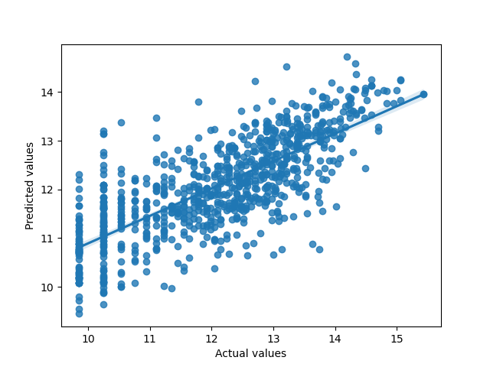
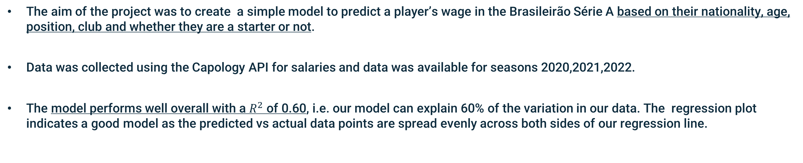
Model Overview
The aim of the project was to create a simple model to predict a player’s wage in the Brasileirão Série A based on their nationality, age, position, club and whether they are a starter or not.
Data was collected using the Capology API for salaries and data was available for seasons 2020,2021,2022.
The model performs well overall with a $R^{2}$ of 0.60, i.e. our model can explain 60% of the variation in our data. The regression plot indicates a good model as the predicted vs actual data points are spread evenly across both sides of our regression line.
Benefits of our model
A sanity check for the wages offered to new Vasco da Gama signings.
Enables well informed wage negotiations.
Aids in benchmarking Vasco da Gama’s wage structure to the rest of the league.
Helps us find similar players to our transfer targets (using the webpage).
Regression plot

Slide 5
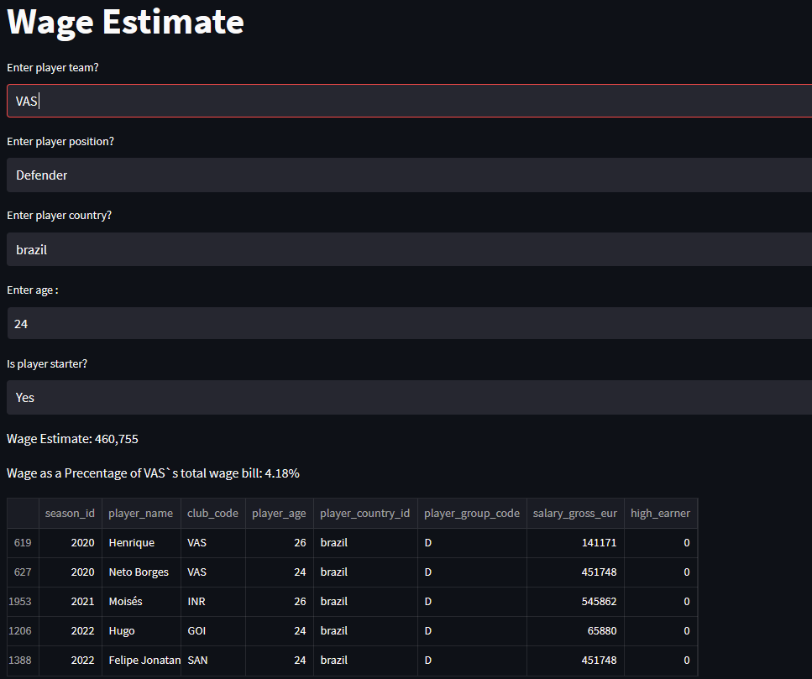
Model Web Page
A website was deployed to give a Graphical User Interface for users to input player data, and a wage estimate of the player will be returned on the webpage by running our model.
Additional features were added to the webpage to aid the decision making process.
Wage as a percentage of the clubs wage bill will be returned by the webpage which is a useful metric to measure how expensive a player relative to rest of the squad
Similar players based on the variables used in the model is returned, enabling the decision maker to validated the model prediction.

Slide 6
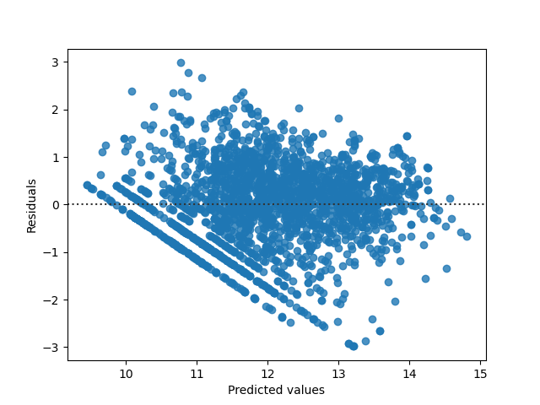
Diagnostics - The Outliers
When performing model diagnostics we noticed parallel lines in the residual plot, suggesting the data may not be linear but ordinal. This implies that some clubs have very different wage/squad structure when compared to the rest of the league.
Residual plot
After further analysis we identified Red Bull Bragantino, Corinthians, Botafogo, Cortiba, Goianese, Sao Paulo, Sport Club do Recife, and Cuiaba as the Outlier Clubs.
Its important to note that Botafogo, Cortiba, Sport Club do Recife and Cuiaba were only in the top flight for two seasons in our data and their wage structure could be different post relegation.

Slide 7
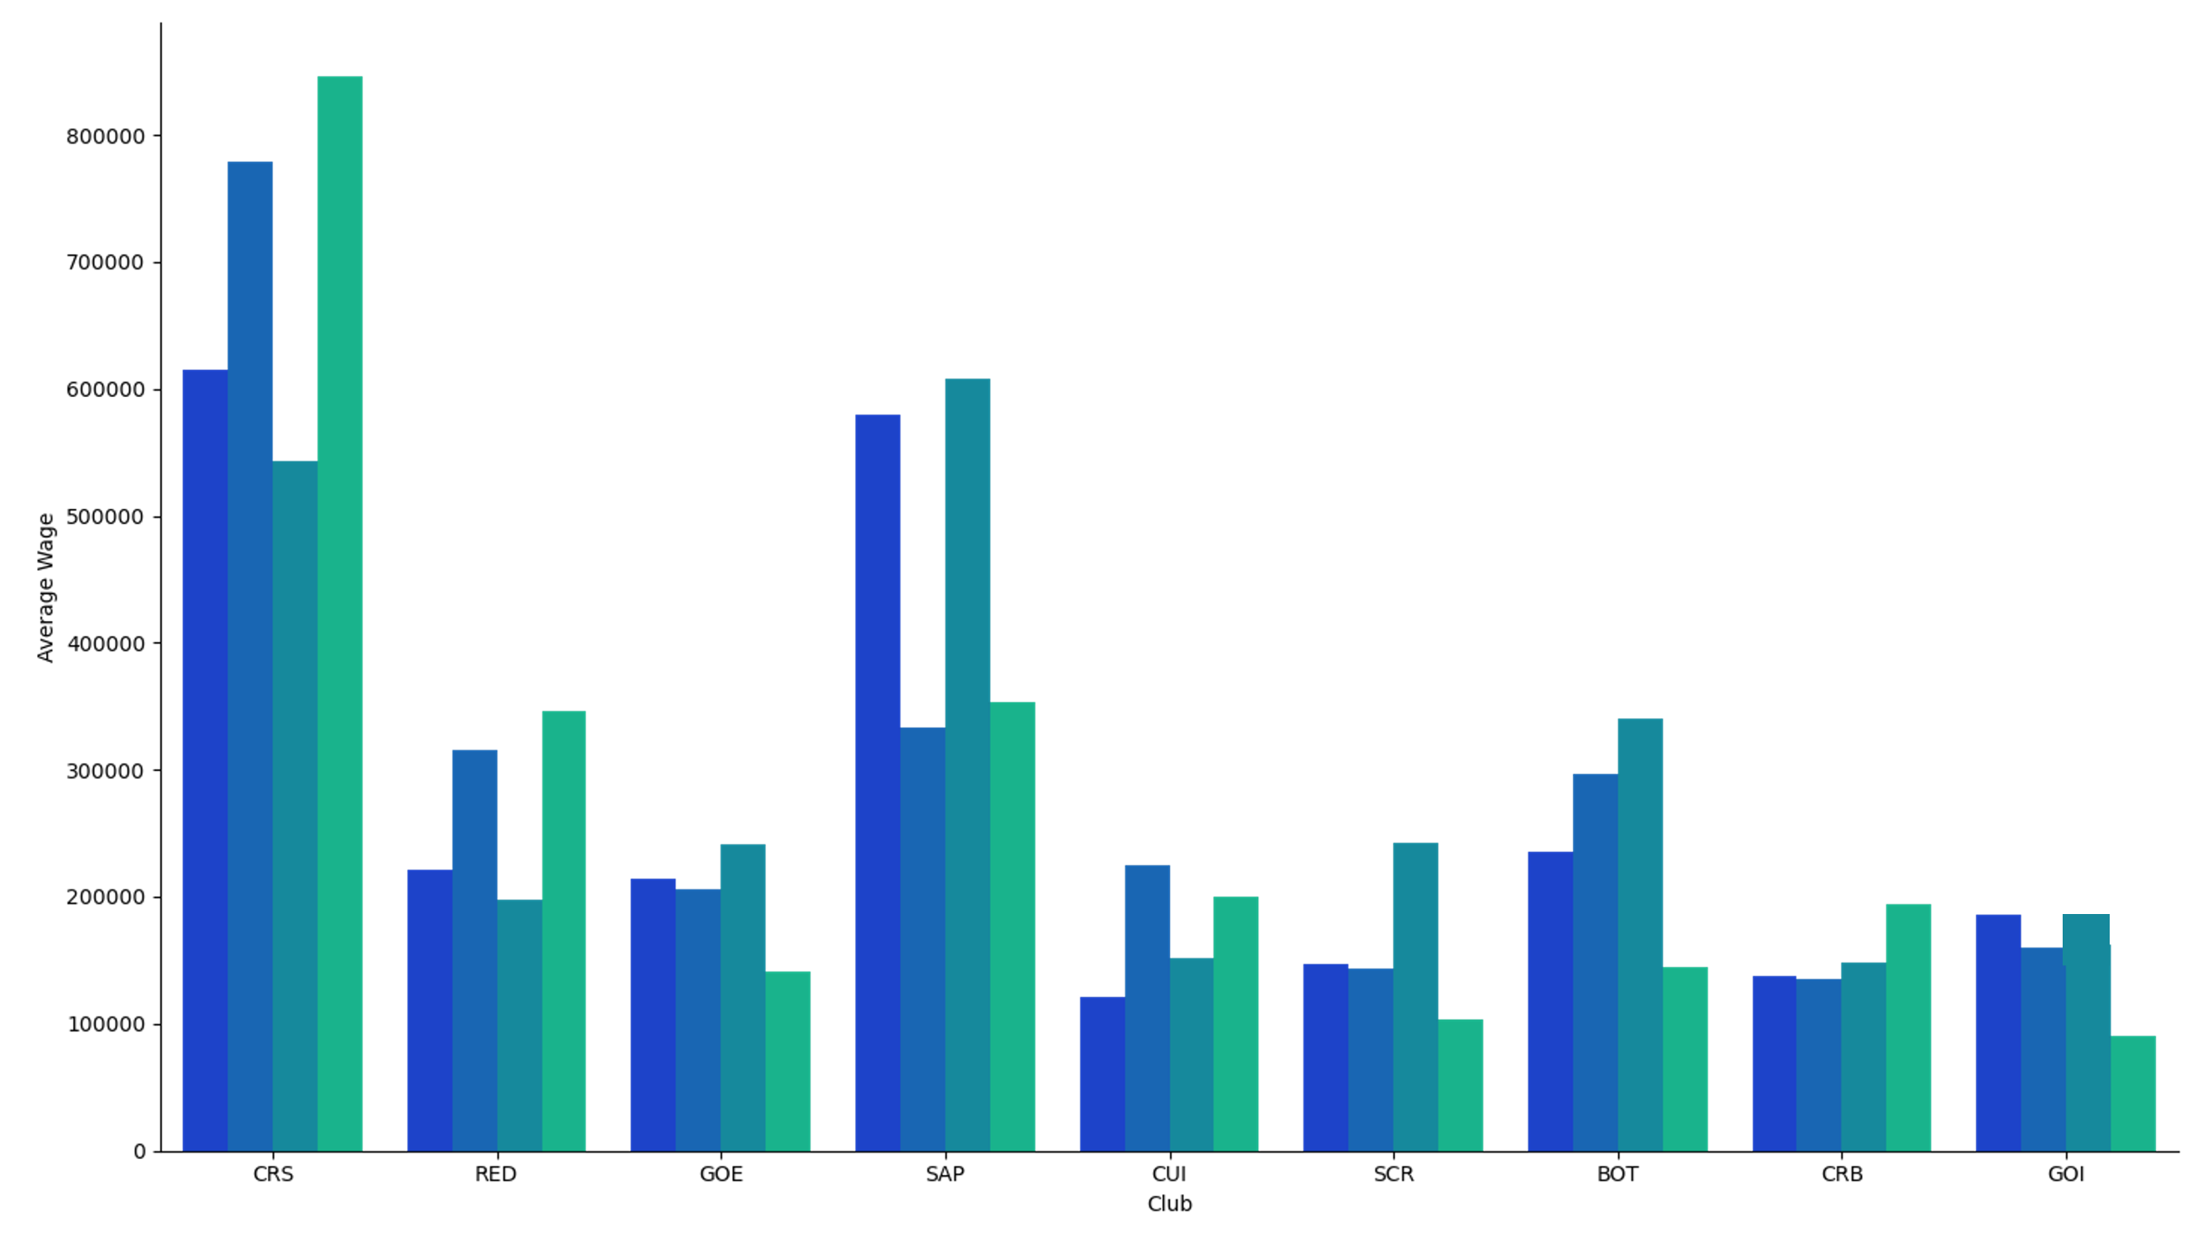
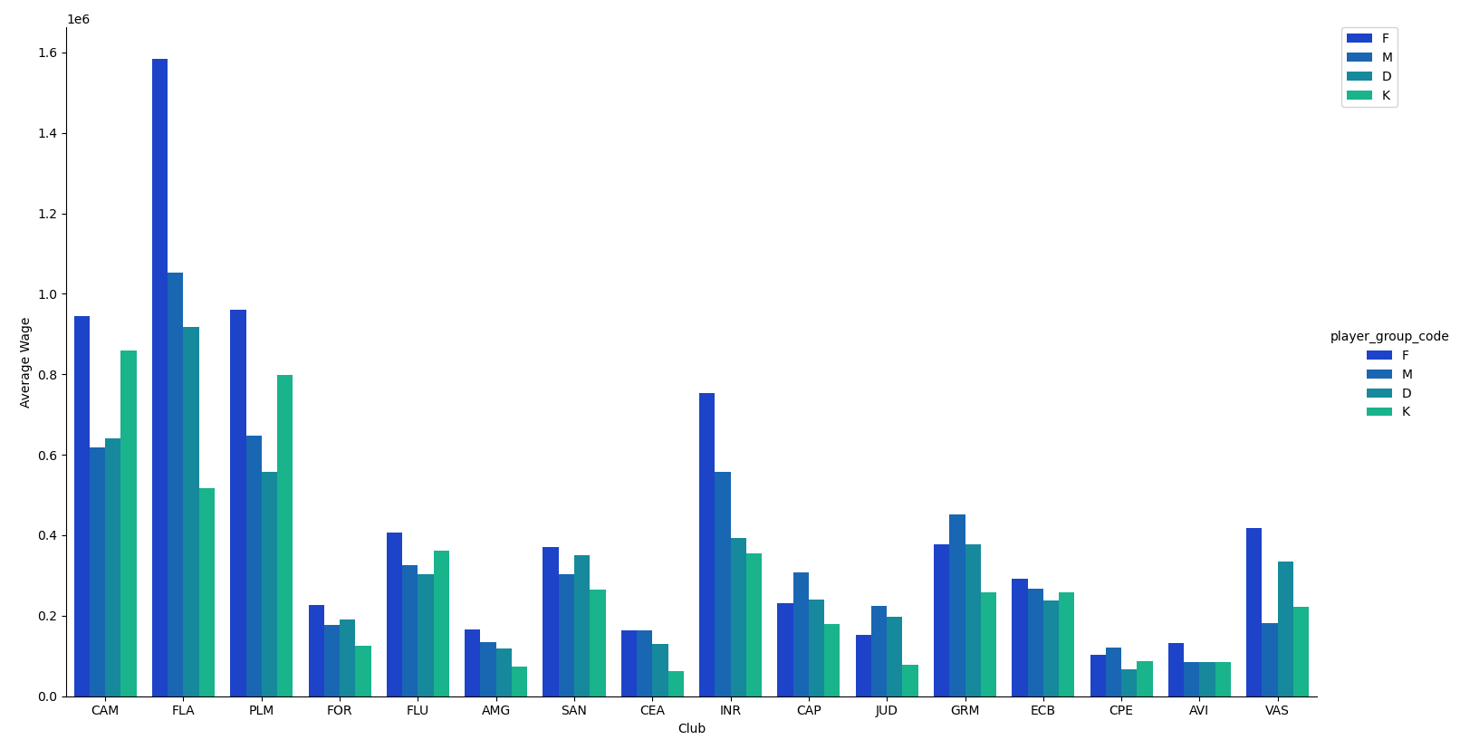
Squad Structure of Outlier Clubs (1/2)
Positions
The outlier clubs have given more importance to their defenders and keepers and tend to pay them on average higher wages compared to rest of the positions.
Forwards
Defenders
Midfielders
Keepers
Average Wage by Position – Outlier Clubs
The rest of the league is focusing more on their forwards and midfielders, paying on average higher wages for those positions compared to defenders and goalkeepers.
Average Wage by Position – Rest of the League

Slide 8
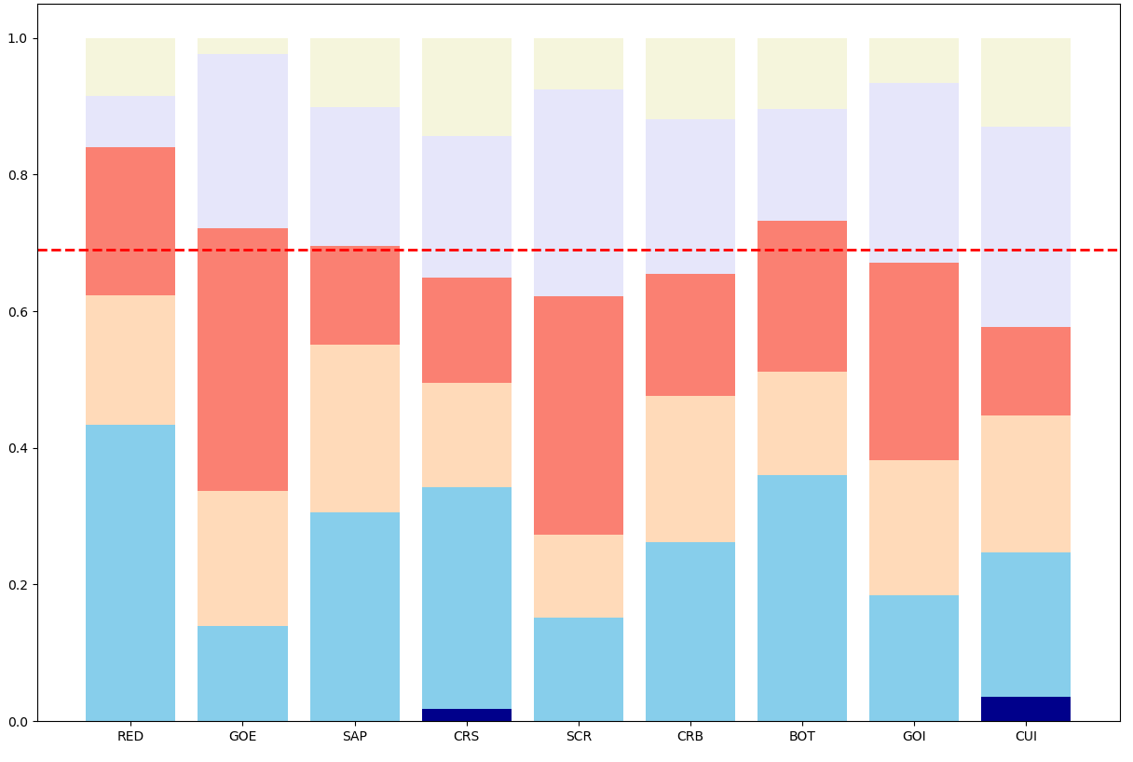
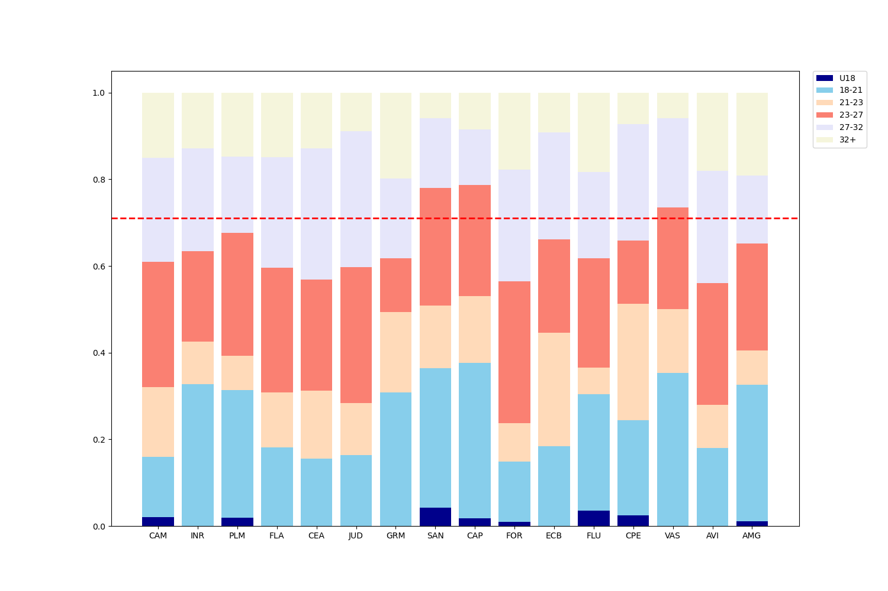
Squad Structure of Outlier Clubs (2/2)
Age
32+
27-32
23-27
21-23
18-21
U18
Squad Composition by Age – Outlier Clubs
Squad Composition by Age – Rest of the League
With the exception of Sport Club do Recife and Cuiaba, the rest of the outlier clubs have young squads with almost 70% (red line) of the squad comprising of player under the age of 27.
The squad Red Bull Bragantino in particular is made up of over 40% players under the age of 21 more than any other team in the league.
The rest of the league favours more experienced players in their prime (age 27+), with the exception of Athletico Paranaense, Santos, and Vasco da Gama.
A hypothesis test with 95% significance level confirmed that the hypothesis, outlier clubs have a younger squad is supported by the data.

Slide 9
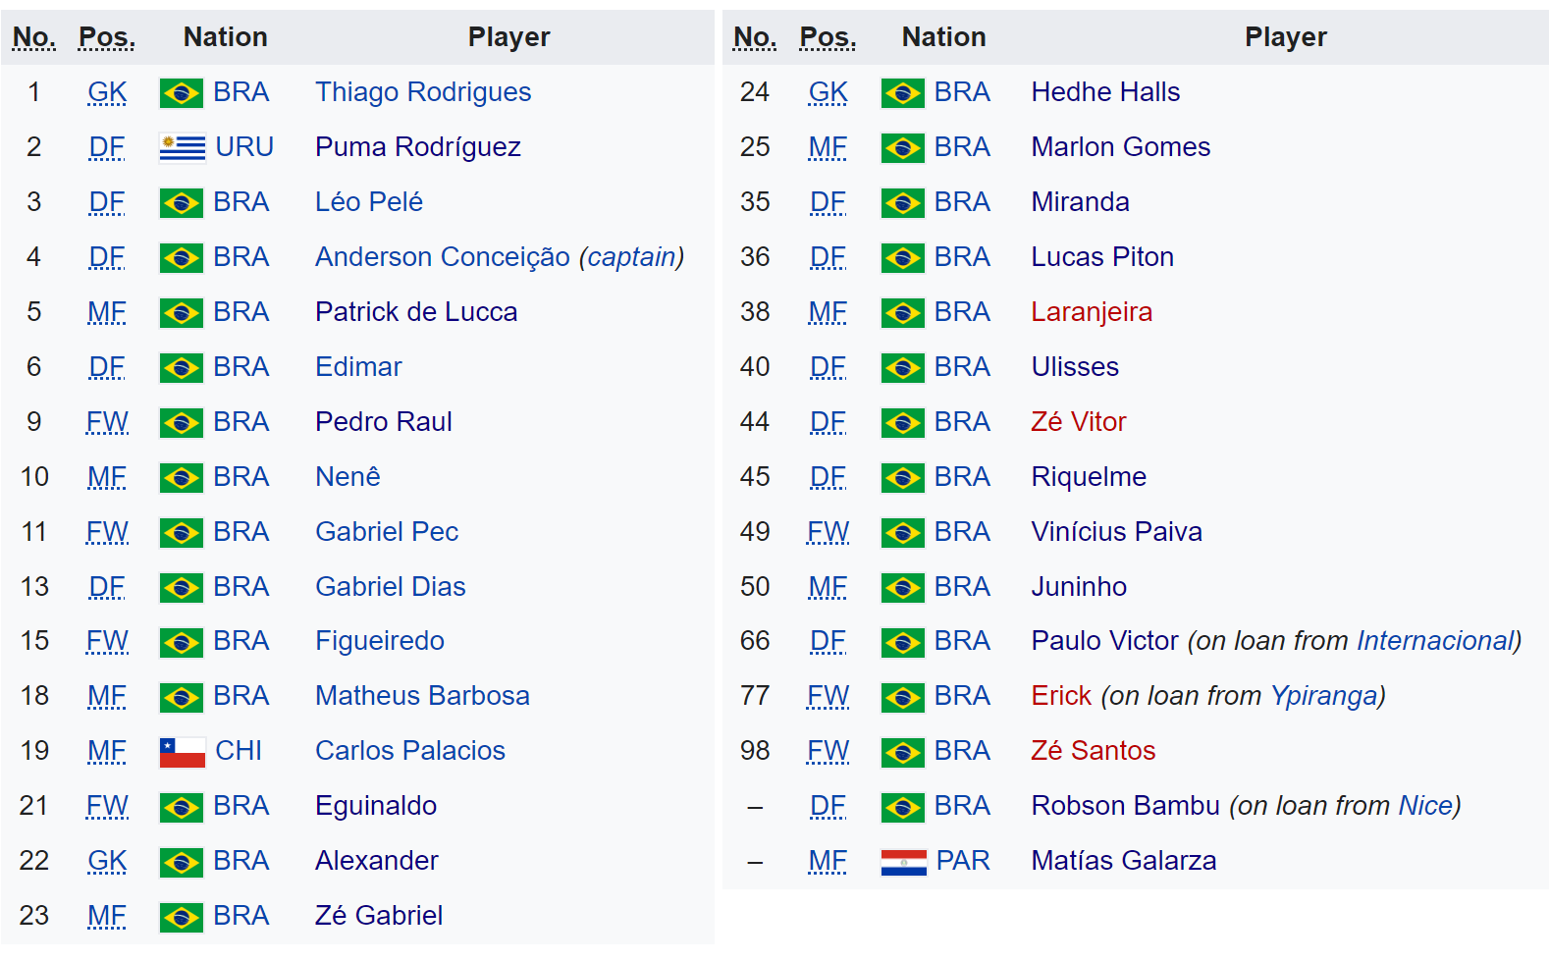
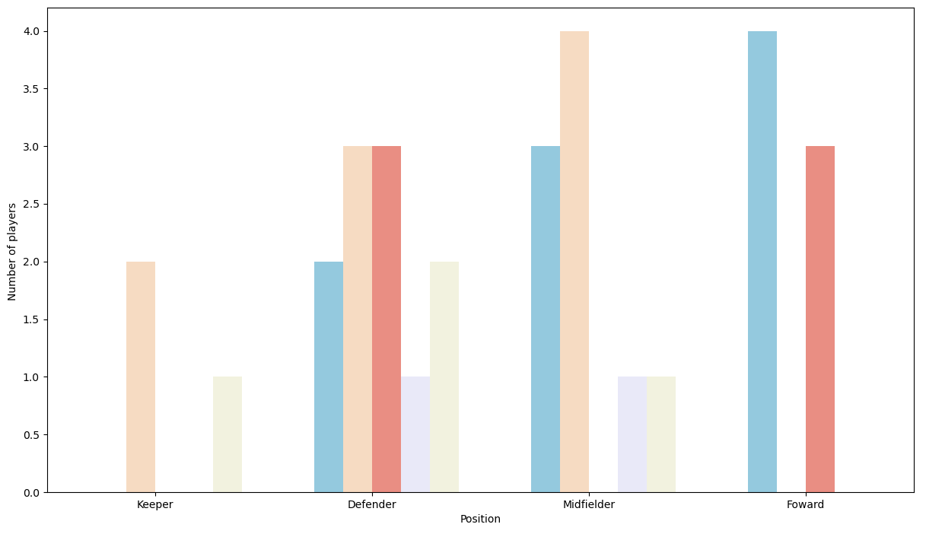
Current Squad -Vasco
With new additions such as Robson Bambu, Erick ,Paulo Victor and others, Vasco squad is well fortified. There are good back up options for each position should an injury occur.
In particular there is excellent squad depth for defenders and midfielders, as the squad comprises of 11 defenders and 9 midfielders.
Age
32+
The squad is well balanced with a good mix of young players and experienced veterans.
27-32
23-27
21-23
18-21
U18
Number Players per Position by Age

Slide 10
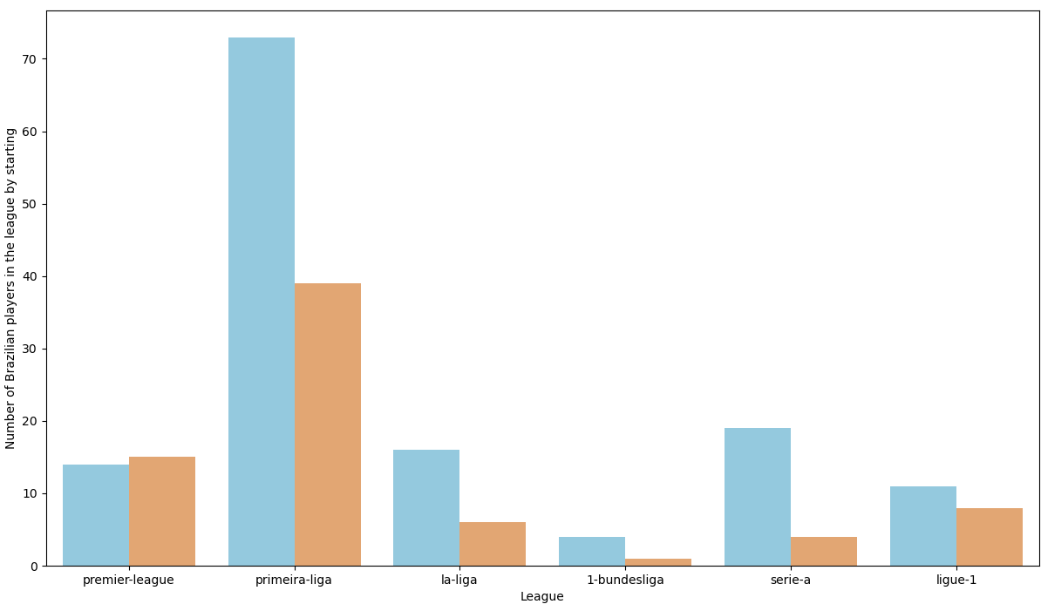
European Leagues with Potential Recruits (1/3)
With the squad limit on signing of foreign players, recruitment of Brazilian players is vital.
Most clubs in the league are focusing their recruitment in Brazil and other South/Central American leagues.
There is value to be gained by scouting the top 6 European leagues as there are over 200 expats in the leagues. Some players have moved to Europe early in their career but are currently failing to find regular game time. These players could be bought to Vasco for nominal transfer fees/wages with the promise of regular game time.
High Earner
High earners was used as a proxy to find the regular starters in the team.
The top 2 players with the highest wage for their position in their club was flagged as high earners.
As seen in the plot Primeria Liga, La Liga, Serie A and Ligue 1 have a high number of non starting Brazilian players.
These leagues will be of particular interest to us, and further metrics were added to filter down players.
No
Yes
Number of Players in the Top 6 European Leagues by High Earner or Not

Slide 11
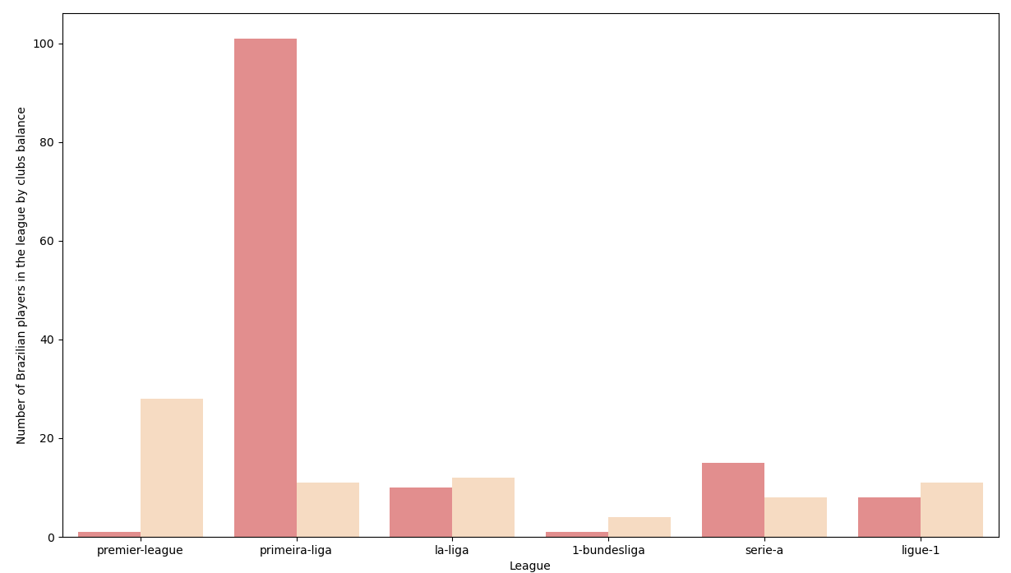
European Leagues with Potential Recruits (2/3)
Negative Balance
No
Yes
Number of Players in the Top 6 European Leagues by Clubs Transfer Balance
We added an additional feature to our database of Brazilian Expats in the top 6 European Leagues to flag players from clubs with a negative transfer balance for 2023.
This information can be leveraged in transfer negotiations.
La Liga is an attractive league to scout as most Brazilian players in the league belong to clubs with negative balances and are mostly non-starters. Similar trend can be seen in Ligue 1.
Most clubs in Premieria Liga have a positive transfer balance.

Slide 12
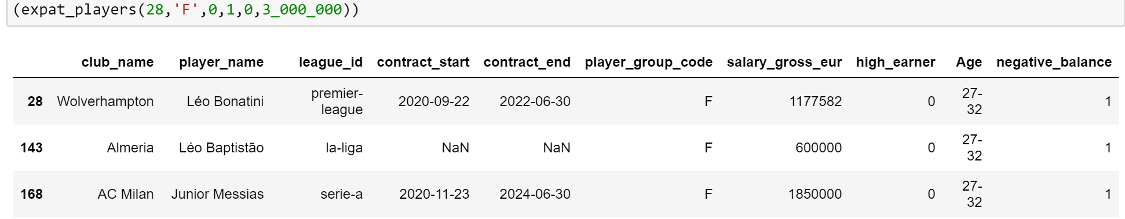
European Leagues with Potential Recruits (3/3)
We created a function to filter and find players matching our requirements. The function takes in player age, position, whether we are looking for a starter or not, filter for negative balance clubs and the lower/upper wage bound as inputs:
The function will search for players who match our transfer requirements in the database of Brazilian players in the European top 6 leagues and returns the players who match our criteria.
Here in the example the function will return forwards in the age group 27-32, who are not starters, are from club with negative transfer balance and who have a wage less than €3,000,000.
Contract expiry details of players was also added to the data frame when data was available.

Slide 13
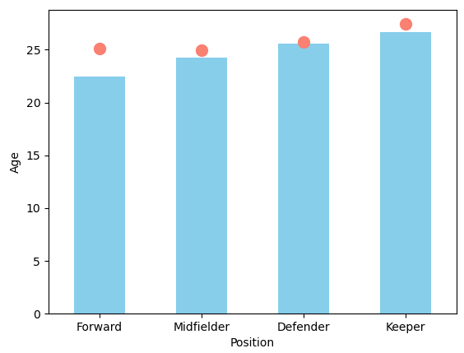
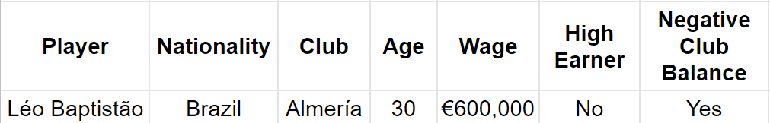
Sensible Transfers
Short Term solution
Considering the lack of depth in forwards compared to rest of the position and the younger age of the current forwards in comparison to rest of the league, signing a forward in the age bracket 28 – 32 is sensible.
Our top pick is Léo Baptistão from Almeria ;
League
Average
He has previously played for several La Liga clubs including Athletico Madrid, Espanyol and Rayo Vallecano. He also had a stint in Santos.
His current wages are around the average wage of a forward in the Vasco team which is ~€430,000 (for 2020). Almeria is currently running a negative transfer balance, leveraging this we could buy him for a cheaper price.
He could provide the experience and backup needed for the forwards.
Average Age by Position – Vasco da Gama
Long Term Solutions
We should use a similar recruiting strategy to Red Bull Braggantino who were promoted to Brasileirão Série A in 2019 and had remained in the top flight since.
We should give more first team opportunities for players from the youth team and aim to recruit players aged 18 - 21.
We should primarily focus on recruiting defenders and goalkeepers, since our starting keeper is 34 , and two defenders are over 33 including the club captain.
The squad, although well balanced is lacking the experience in the frontline compared to the rest of the league.
Average age of a Vasco forward is 22.4 while the overall league average is 25.1 (For the past 3 seasons).
Vasco is on par with rest of league for rest of the positions.

Slide 14
Thank you !
Q&A

